Slide 1
Course : COMP8043 – Machine Learning
Period : September 2020
Recommender System
Session 9
KDS – Amalia Zahra, S.Kom., Ph.D.

Slide 2
Learning Outcomes
After the completion of this session, students are expected to achieve the following learning outcomes:
LO2: Describe the characteristics of various Machine Learning algorithms and understand how each of them works, including the mathematical principles underlying the algorithms.
LO3: Apply relevant Machine Learning algorithms according to individual cases/problems and perform evaluation.
LO4: Analyse the results obtained from Machine Learning experiments from several perspectives.

Slide 3
Session Outcomes
By completing this session, you will be able to:
Describe the concept of recommendation system
Summarize steps in content-based recommendation system
Summarize steps in collaborative filtering

Slide 4
Topics
Introduction to Recommender System
Content-Based Recommender System
Collaborative Filtering

Slide 5
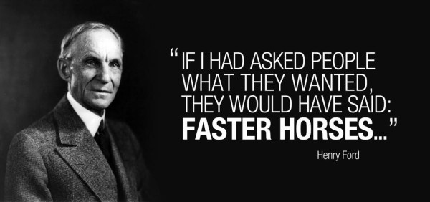

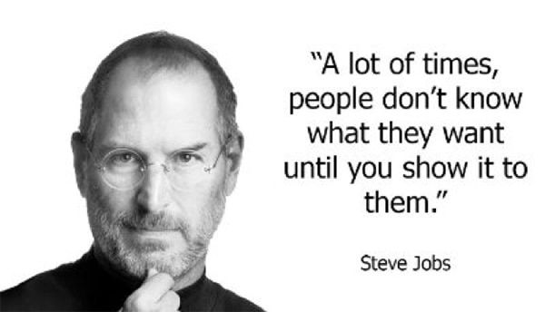

Slide 6
INTRODUCTION TO RECOMMENDER SYSTEM

Slide 7
Recommender System
Recommender system describes patterns coming from human behavior and predicts what they want or like.
Example: If you purchase a book entitled “Machine Learning with Python” and you like reading it, then you may also like a book about Data Visualization.
Someone would like the same preference as those in their life.
Recommender systems are widely implemented to applications that we might already know.

Slide 8
Recommendation Engine - Examples
Facebook – “People You May know”
Netflix – “Other Movies You May Enjoy”
YouTube – “Recommended Videos”
LinkedIn – “Jobs You May Be Interested In”
Google – “Search results adjusted”
Pinterest – “Recommended Images”
Amazon – “Customer who bought this item also bought …”

Slide 9
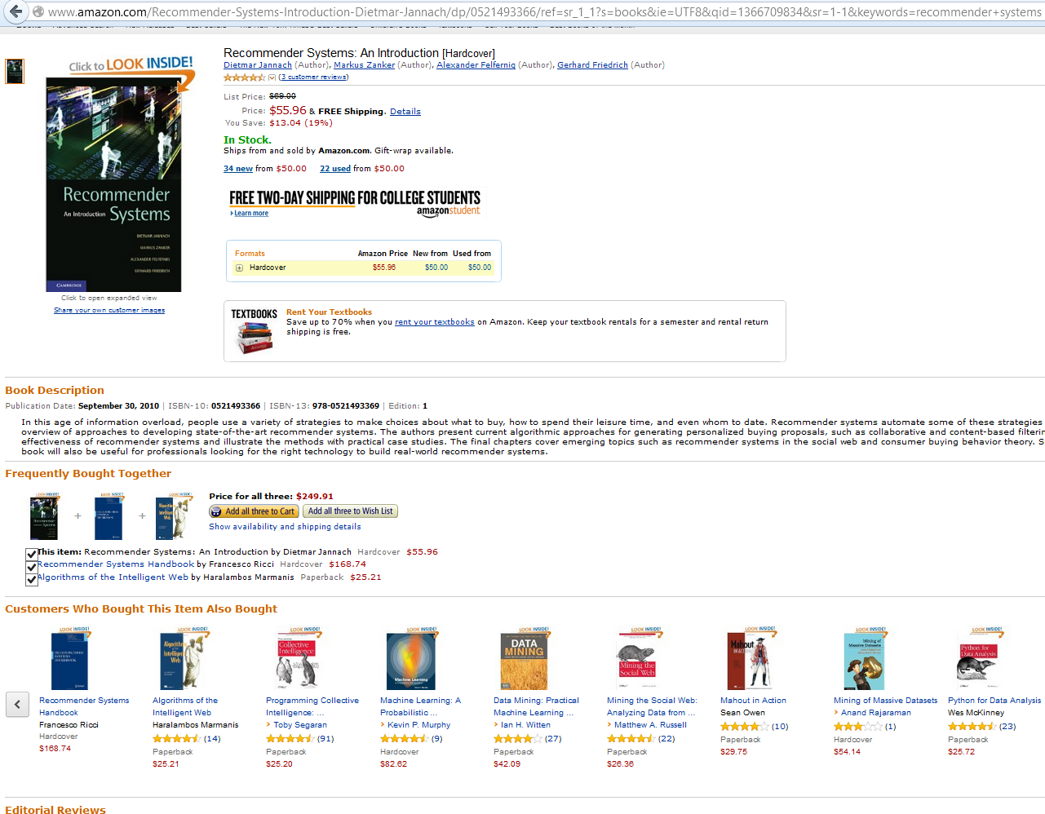

Slide 10
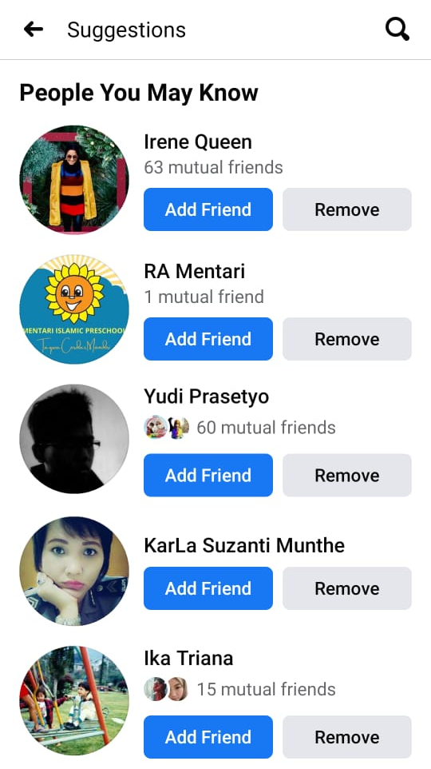

Facebook

Slide 11


Slide 12
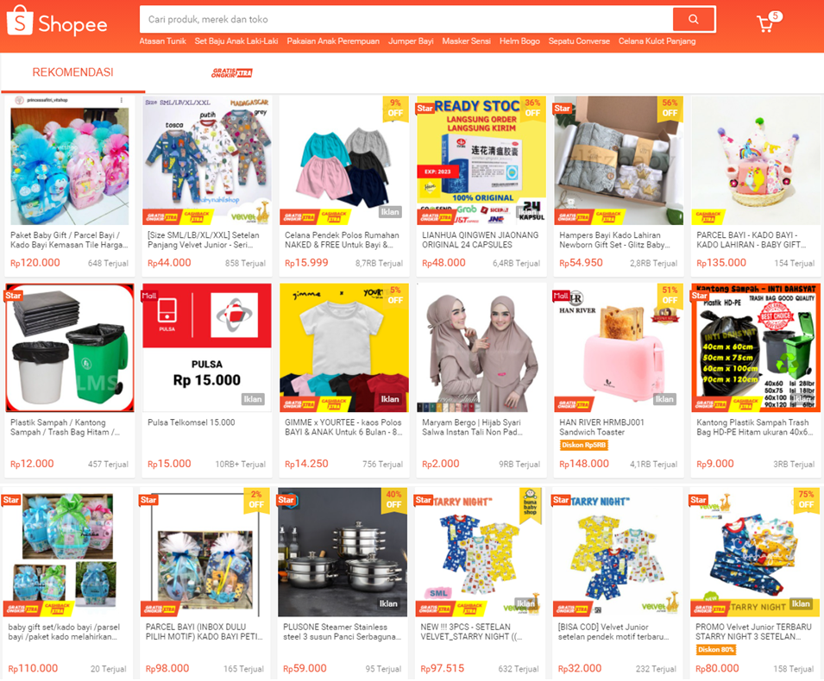

Slide 13
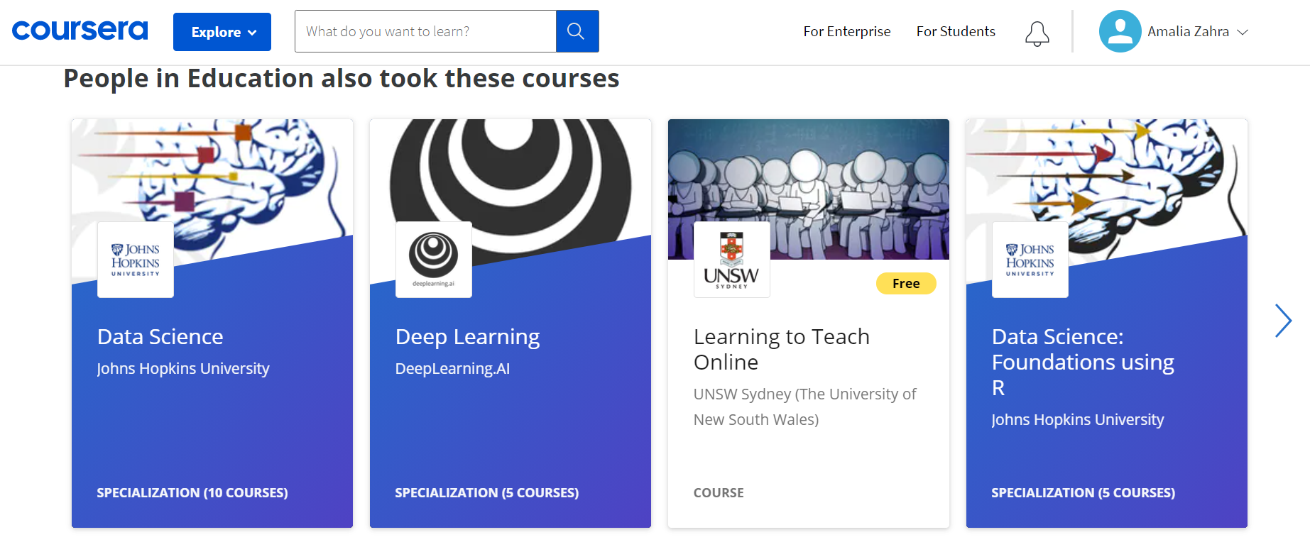
recommendation
and the list goes on and on …

Slide 14
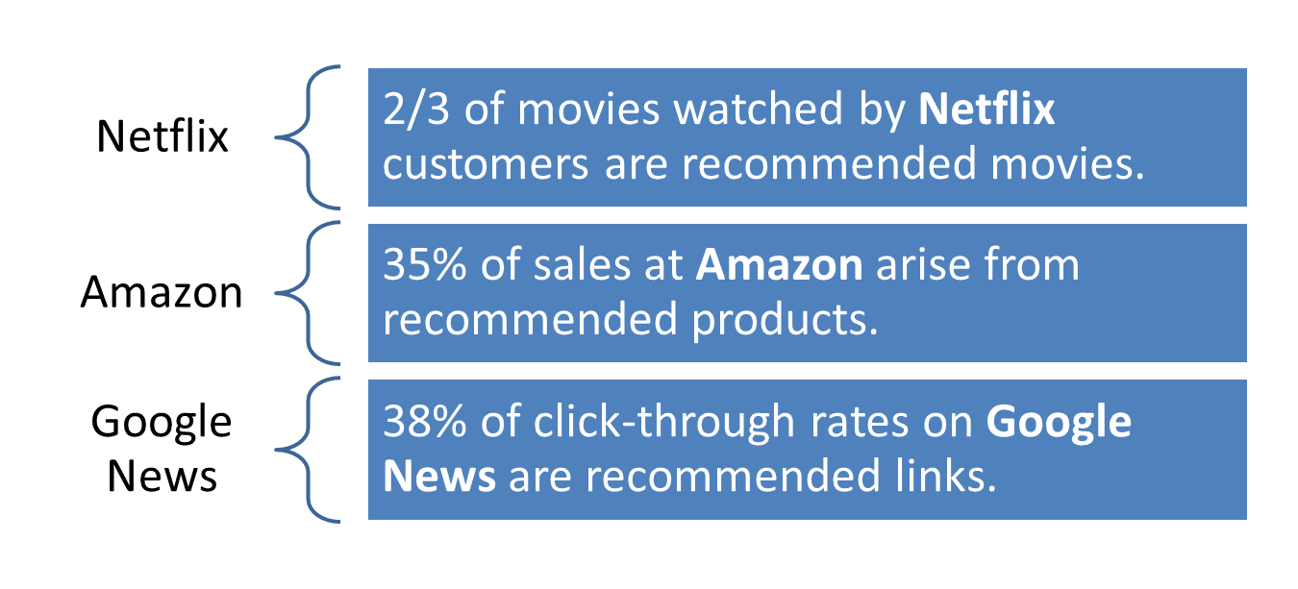
Advantages of Recommender Systems
Why should we use recommendation systems?

Slide 15
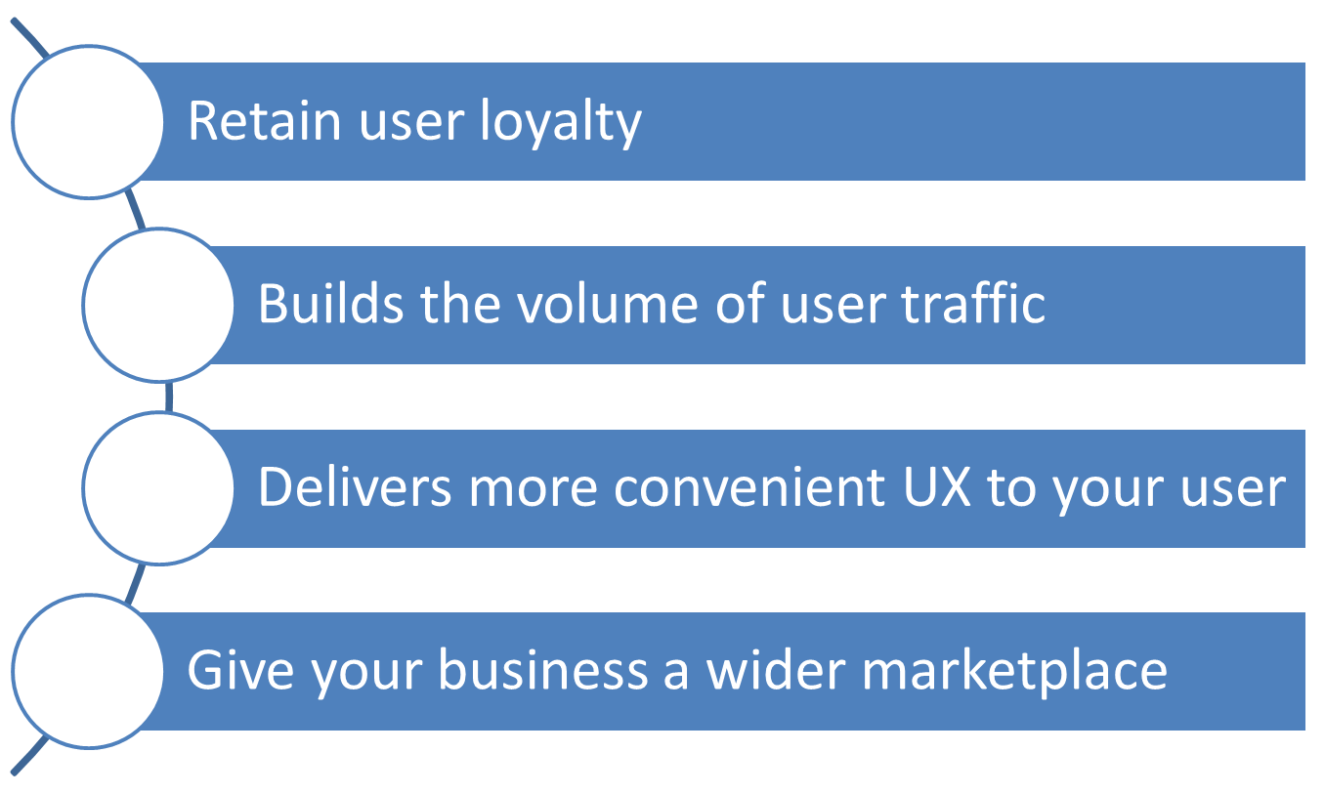
Beneficial Features of Recommendation Engine to Marketers
1
2
3
4

Slide 16
Types of Recommendation System
Content-Based System
  Focused on items/products
Collaborative Filtering
  Focused on users

Slide 17
Implementation of Recommendation System
Memory Based
  Using the whole dataset of items selected by users as the basis of creating recommendation.
  Using statistical approach to measure user’s choice on items, such as Pearson Correlation, Cosine Similarity, Euclidean Distance, etc.
Model Based
  Building a model of user based on their behavior.
  Using Machine Learning approach, such as regression, clustering, classification, etc.

Slide 18
CONTENT-BASED RECOMMENDER SYSTEM

Slide 19
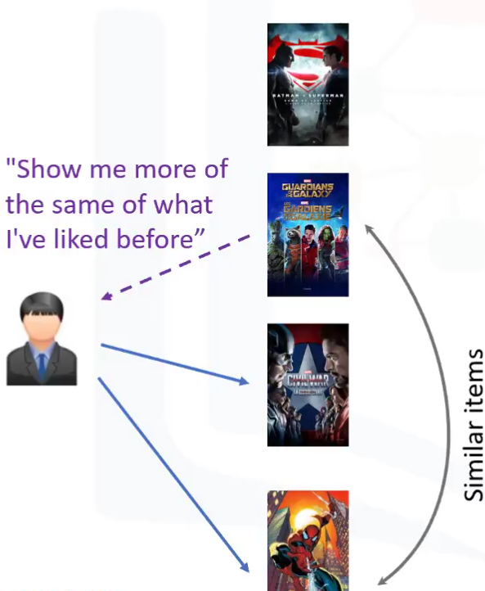
Content-Based Recommender System
Main idea (focused on items selected): recommend items to User A based on selection history that has the highest rating.
Example:
  Movie recommendations
    recommend movies with same actor(s), director, genre, …
  Websites, blogs, news
    recommend other sites with “similar” content.

Slide 20
Content-Based Recommender System
Using history of items selected by users.
An item is described based on features, such as:
  actors, director, category, words in the description, etc.
Training is performed by regression model from every user based on features of each item.

Slide 21





Illustration
likes
likes
similar item
recommendation
Note:
selection history
similar item
recommendation

Slide 22






Example: Film Recommendation
(Adventure ,Super hero)
Batman vs Superman
(Comedy, Adventure, Superhero, Scifi)
2
Guardian of Gallaxy
(Comedy,Superhero)
10
Captain Amerika:
Civil War
8
(Comedy, Adventure, SciFi)
?
Hitchiker’s Guide to
Galaxy
?
(Superhero)
?
Batman Begin
(Comedy, Superhero)
Spider man

Slide 23
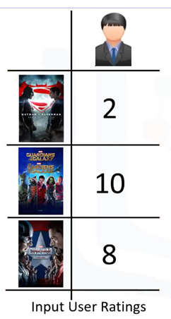
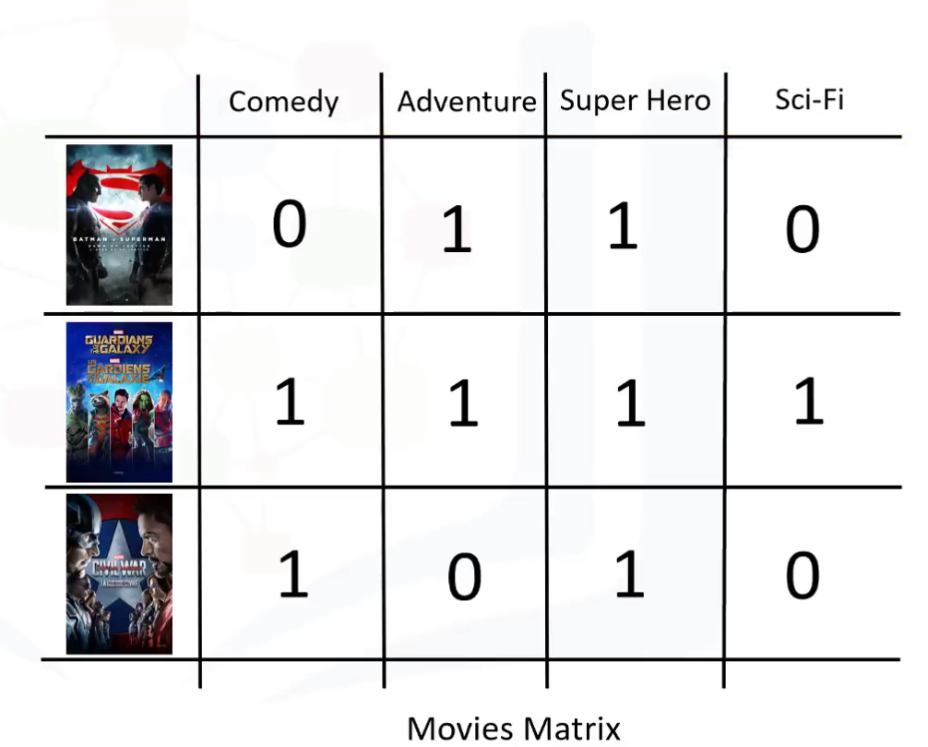
Weighting Genre

Slide 24
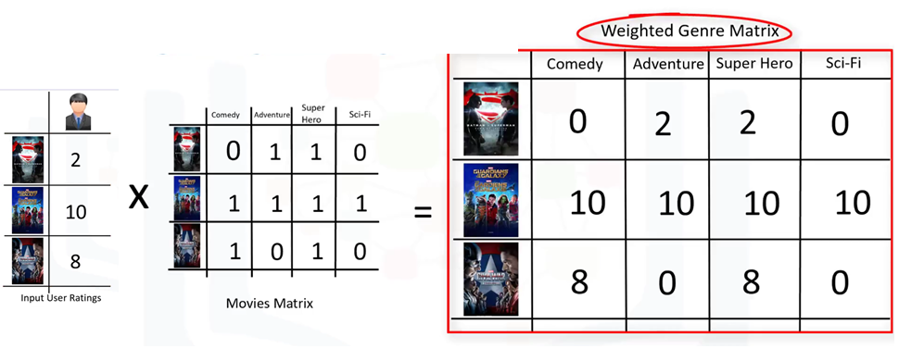
Weighting the Genres

Slide 25
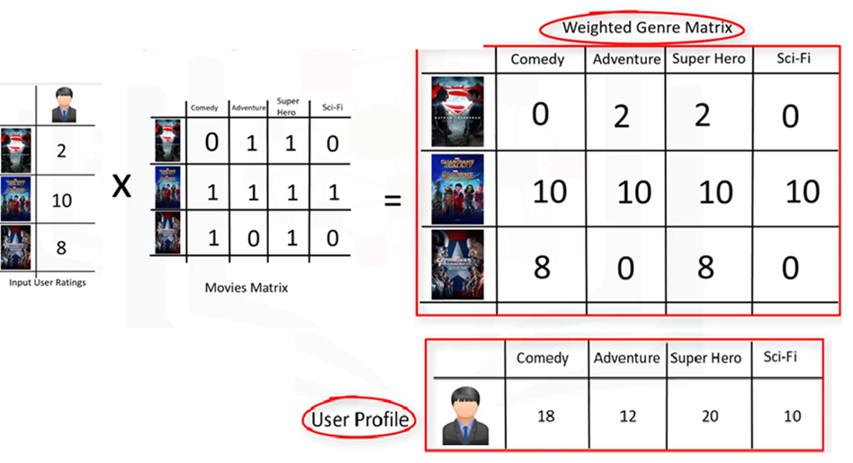
Weighting the Genres

Slide 26
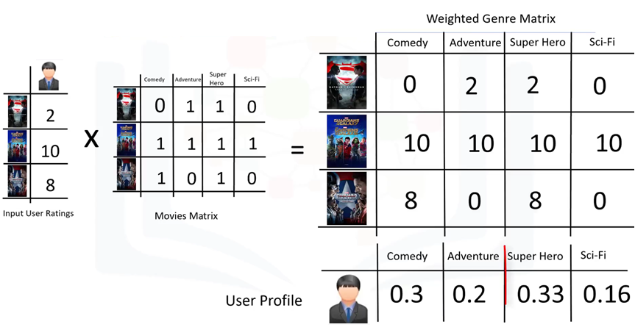
Weighting the Genres

Slide 27
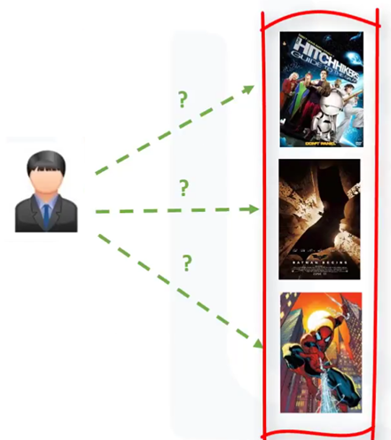
Candidate Movies for Recommendation

Slide 28
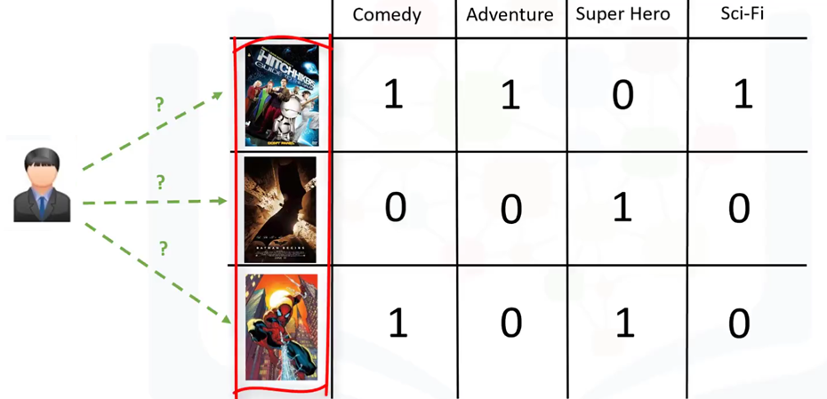
Candidate Movies for Recommendation

Slide 29
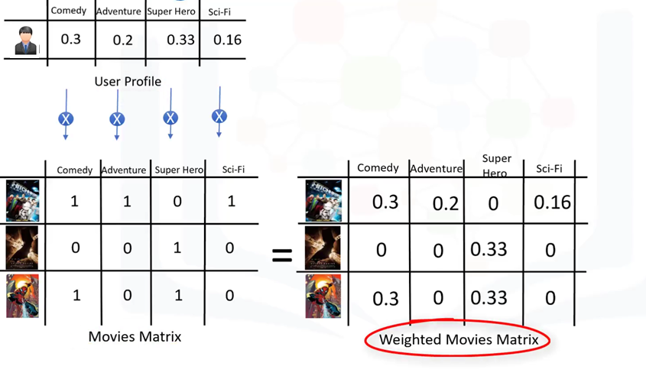
Finding Recommendation

Slide 30
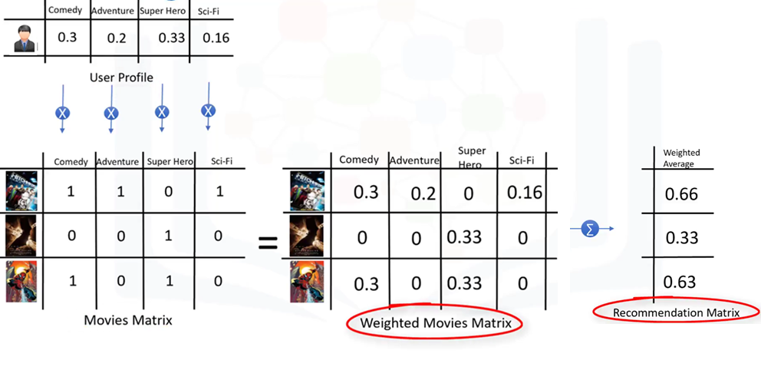
Finding Recommendation

Slide 31
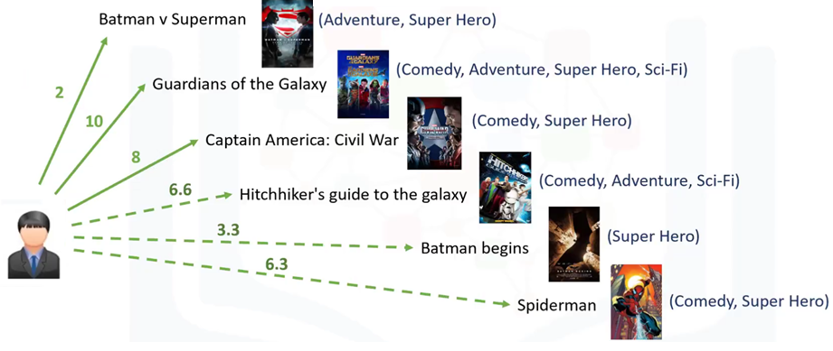
Finding Recommendation

Slide 32
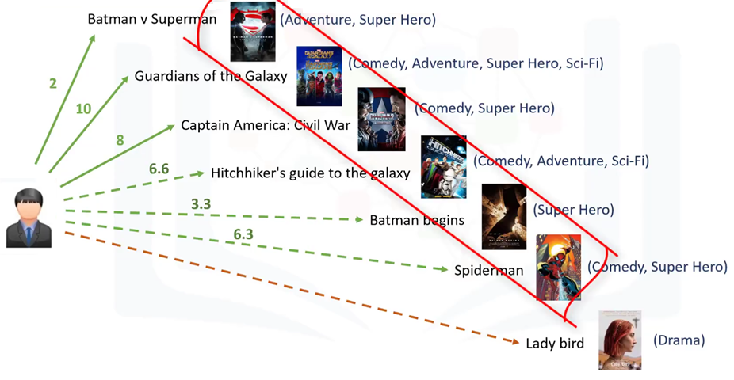
Recommendation cannot be found if there is no item category

Slide 33
COLLABORATIVE FILTERING

Slide 34
Collaborative Filtering
Main idea (focused on users):
  Users give rating (explicitly or implicitly) to items.
  Users who have similar tendency will select similar items.

Slide 35
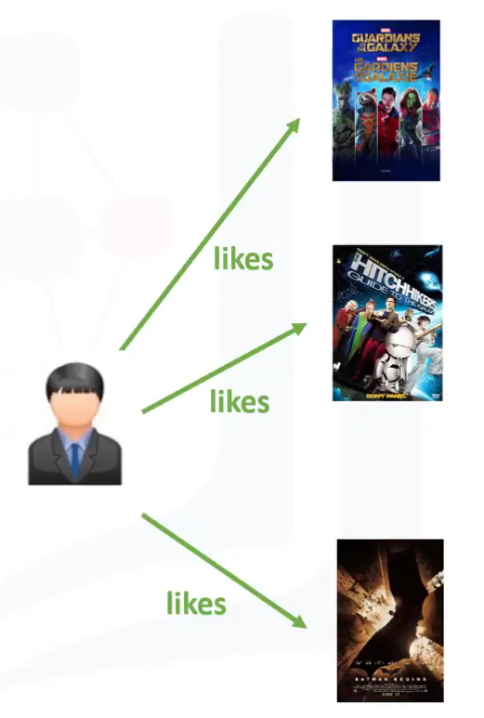
Types of Collaborative Filtering
User-based collaborative filtering
  Based on ‘users’ neighborhood
Item-based collaborative filtering
  Based on item’s similarity

Slide 36
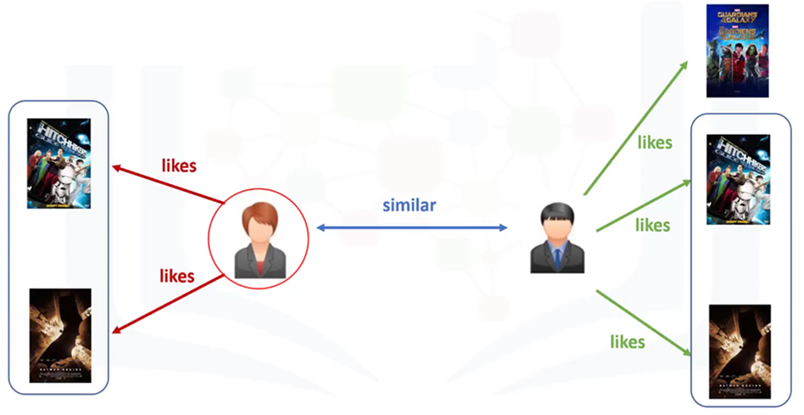
User-Based Collaborative Filtering
recommends

Slide 37
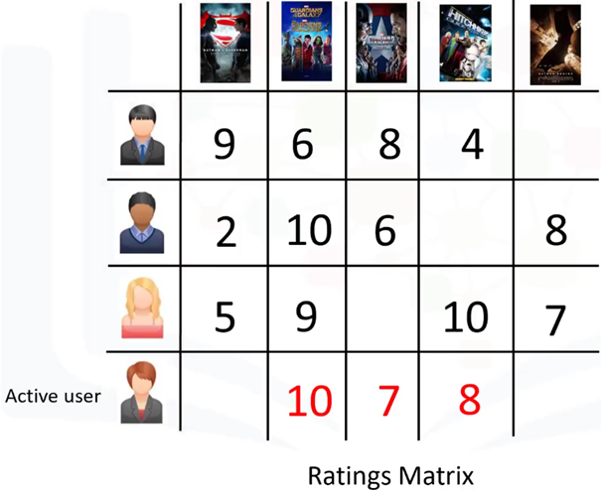
User-Rating Matrix
?
?

Slide 38
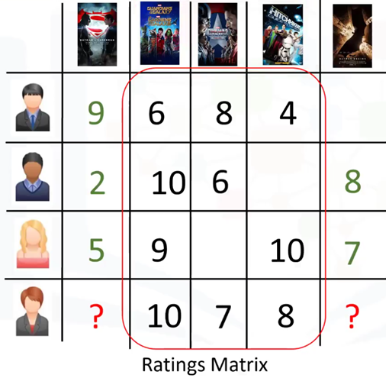
Computing Similarity Weight
0.4
0.9
0.7

Slide 39
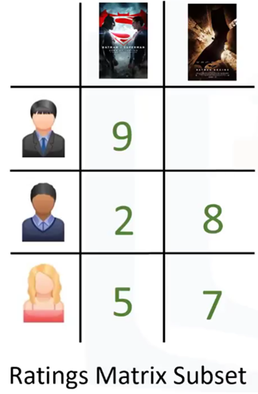
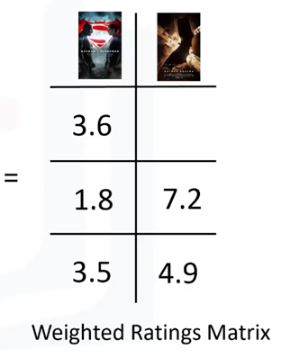
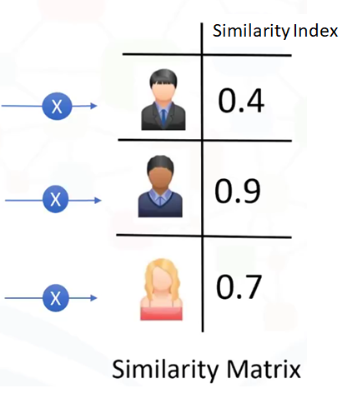
Creating Weights from Rating Matrix

Slide 40
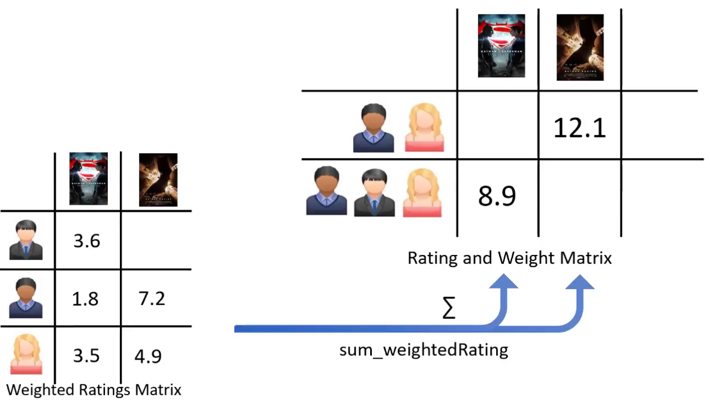

Slide 41
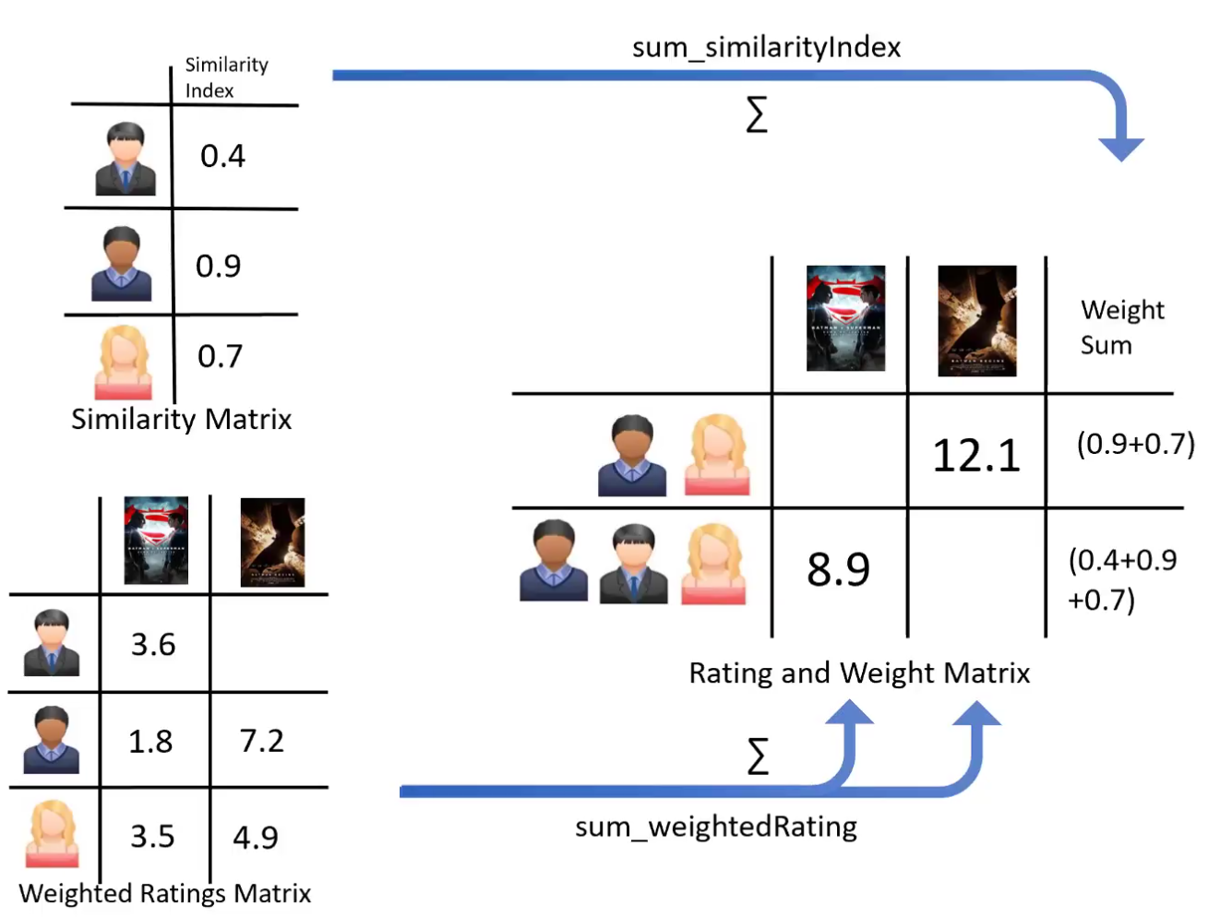

Slide 42
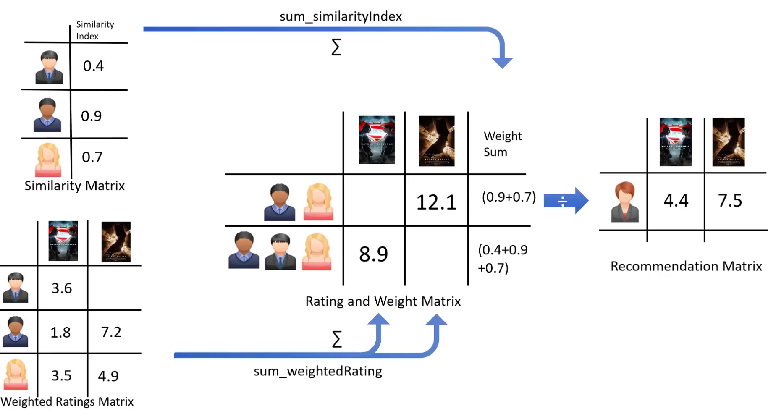

Slide 43
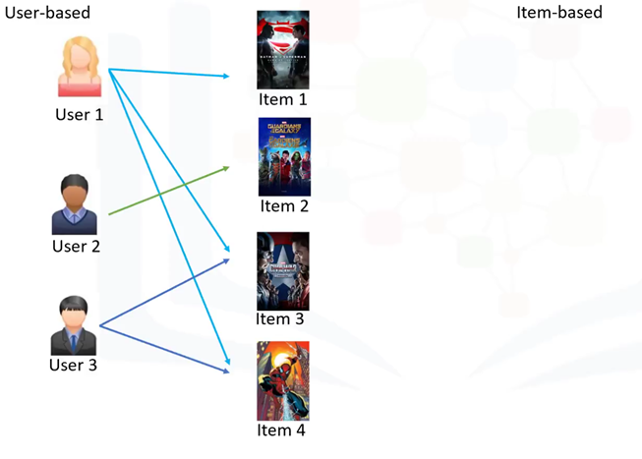
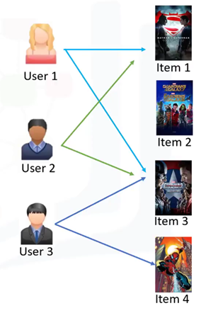


Item-Based Collaborative Filtering

Slide 44
Challenge of Collaborative Learning
Data Sparsity
  User, in general, rates only a limited number of items.
Cold Start
  Difficulty in recommendation to new users or new items.
Scalability
  Increase in number of user or items.

Slide 45
References
Mohanty, S.N., et al. (2020). Recommender system with machine learning and artificial intelligence: Practical tools and applications in medical, agricultural and other industries. John Wiley & Sons.

Slide 46
Q&A

Slide 47


